Slide 1

DATA STORAGE IN DNA
Presented By
Ajay Arun Raut
Class : TE-3
Roll No: 305C051
Under the Guidance of
Prof. S.S.Peerzade
Sinhgad Technical Education Society's
Department of Computer Engineering
Sinhgad College Of Engineering Vadgaon bk Pune-41

Slide 2
Contents
      Introduction
      What is DNA?
      What is digital Data Storage in DNA?
      History
      Why DNA as storage medium?
      How is data stored in DNA?
      Encoding and Decoding Techniques
      Advantage and Disadvantage
Data storage in DNA

Slide 3
Introduction
The demand for data storage devices is increasing day by day as more and more data is generated every day.
Presently devices such as optical discs, portable hard drives, and flash drives are used to store data.
All these non-biodegradable materials used in data storage pollute the environment.
As the data increases, the current data storage technology would not be enough to store data in future as data is growing every day.
To backup our data, we are using various hard drives and big data centers to harvest the important data.
Data storage in DNA
Topic Name

Slide 4
Importance of DNA as storage medium
High capacity
High data storage density
Withstand extreme environmental conditions
High memory space
Secure as invisible to human eye
Effective power usage
Can store data for long periods by protecting from
water and oxygen
Data storage in DNA

Slide 5
Identified failures of existing storage media
Prone to damage from high temperature, moisture and magnetic ﬁelds.
Function only within limited temperature range.
Subject to decay over long period.
Non-bio degradable.
Release high amounts of heat energy.
Uses more energy for functioning.
Robotic Disaster Response

Slide 6
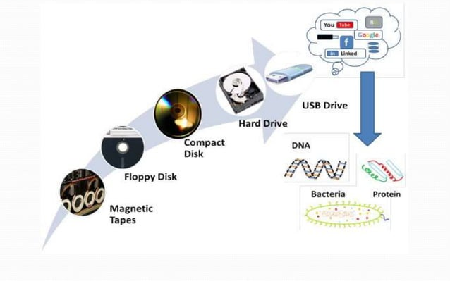
Data storage in DNA

Slide 7
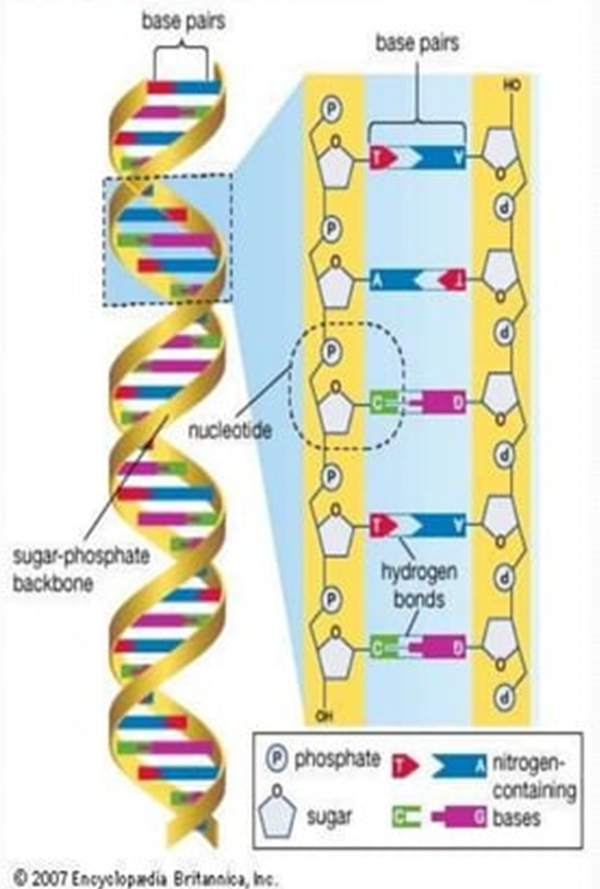
What is DNA ?
  Deoxyribonucleic acid ( DNA) is a molecule that carries the genetic information that used in the growth, development, of all living organisms.
  The two DNA strands are called
  polynucleotides since they are
  units called nucleotides. Each
  nucleotide is composed of one of ‘ .
  four nitrogen containing nucleobases – cytosine(C), guanine(G),
  adenine(A) or thymine(T).
Data storage in DNA

Slide 8
What is digital data storage in DNA?
DNA digital data storage refers to any process to store
digital data in the base sequence of DNA.
This technology uses artiﬁcial DNA made using
commercially available oligonucleotide synthesis
machines for storage and DNA sequencing machines
for retrieval.
This type of storage system is more compact than
current magnetic tape or hard drive storage systems
due to the data density of the DNA.
Currently it was reported that in 1 gram of DNA 215
petabytes (215 million gigabytes) could be stored.
Data storage in DNA

Slide 9
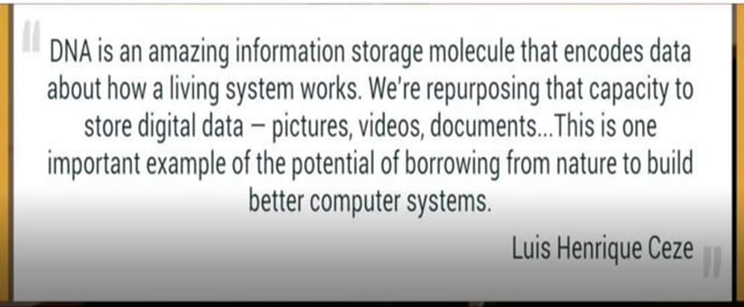
Data storage in DNA

Slide 10
History
The idea and the general considerations about the possibility of
  recording. storage and retrieval of information on DNA molecules were
  originally made by Mikhail Neiman and published in 1964-65 in the
  journal-USSR, and the technology may therefore be referred to as
  MNeimONics, while the storage device may be known as MNeimON
  (Mikhail Neiman OligoNucleotides).
In 2007 a device was created at the University of Arizona, using
  addressing molecules to encode mismatch sites within a DNA strand.
On August 16, 2012, the journal Science published research by George
  Church and colleagues at Harvard University, in which DNA was
  encoded with digital information that included an HTML draft of a
  53,400 word book written by the lead researcher, eleven JPG images
  and one JavaScript program.
DNA Data Storage

Slide 11
An improved system was reported in the journal Nature in January 2013, in an article led by researchers from the European Bioinformatics Institute (EBI) and submitted at around the same time as the paper of Church and colleagues.
The long-term stability of data encoded in DNA was reported in February 2015, in an article by researches from ETH Zurich.
In March 2017, Dr. Yaniv Erlich and Dina Zielinski of Columbia University and the New York Genome Center published a method known as DNA Fountain which allows perfect retrieval of information from a density of 215 petabytes per gram of DNA.
DNA Data Storage

Slide 12
Why DNA as storage medium?
STRUCTURE OF DNA
VERY HIGH DATA STORAGE CAPACITY
LONG LIFE
SMALL SIZE & HIGH DENSITY
PORTABLE
SECURE AS INVISIBLE TO HUMAN EYE
EFFECTIVE POWER USAGE
DNA Data Storage

Slide 13
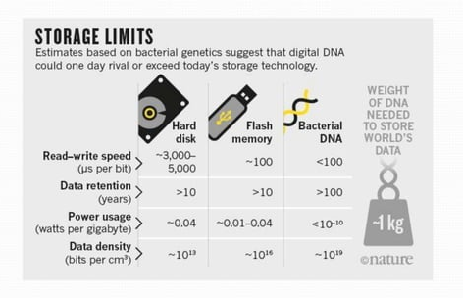
DNA v/s other storage devices
DNA Data Storage

Slide 14
How is data stored in DNA?
METHOD:
There are various techniques for storing the data in the DNA. In all methods, ﬁrstly the inl"'om1ation is converted into digital form if not. Then further processing is done. Various encoding techniques are also used in data storing in DNA, like Huffman coding. The data is converted into binary codes, this process is called as binarization and these binary codes are further converted into A, T, G, C sequence with the help of a device. and this process of conversion is called as DNA encoding. Then further these ATGC sequences are synthesized into DNA molecules. And to read this information back from DNA, sequencing of DNA fragments is done by using various algorithms. And various decoding techniques are used to decode the data from it. Now, question arises is the random access of data possible? Yes in most of the techniques the random access of the data is possible.
DNA Data Storage

Slide 15
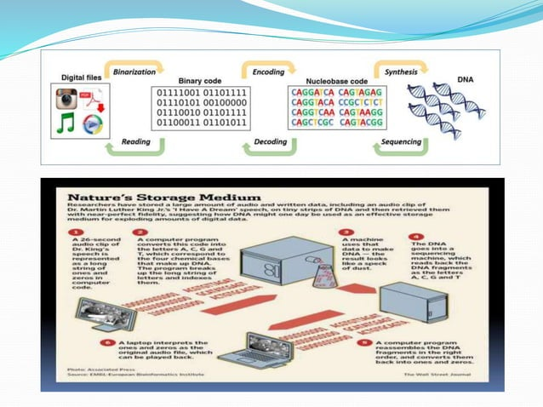
DNA Data Storage

Slide 16
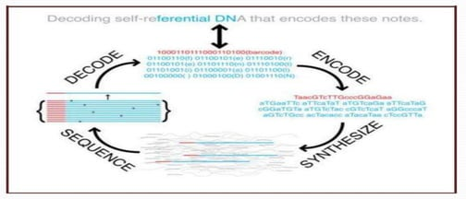
Encoding and Decoding Techniques:
ENCODING DATA ON DNA
Polymerase chain reaction based encoding scheme
Alignment based encoding model
Rewritable and RAM based DNA storage system
DNA Data Storage

Slide 17
Codes for Encrypting Data in DNA
Huffman Coding(varying the length of symbols used
for representing a character)
The Comma Code(Frames are separated with
comma’s)
The Alternating Code
Comma-Free Code(Frames are not separated with
commas)
Improved Huffman Coding Scheme
DNA secret writing algorithm
DNA Data Storage

Slide 18
ADVANTAGES
Highly secure
Compact
Easy to carry
Capable of storing very large amount of data.
Long-lived, stable and easily synthesized.
Needs no active maintenance.
Stores digital ﬁles without electricity for thousands of years.
Last for tens of thousands of years.
We can store 215 petabytes in one gram of DNA.
Highly reliable.
DNA Data Storage

Slide 19
Challenges and Disadvantages
The overall process of encoding, amplifying, sequencing, restructuring and decoding takes signiﬁcantly more time than their conventional counterparts.
The retrieval process is slower than that of a personal computers.
Many types of errors are associated with the current machines dealing with DNA.
Low speed.
Very high cost of production.
Mutations in DNA.
DNA Data Storage

Slide 20
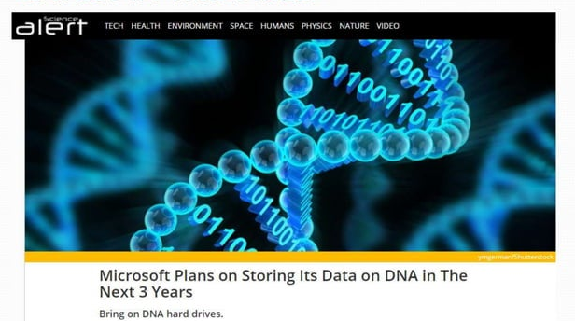
Latest in This Field
DNA Data Storage

Slide 21
Microsoft recently decided to invest in the prospect of storing information with a totally different sort of tech: biotech. lt might seem off-brand for the software giant, but teaming up with academics to take on molecular biology has produced stunning results: The team was able to store and perfectly recall digital data
with incredible storage density. According to an accompanying blog post, they managed to pack about zoo megabytes of data into just a fraction of a drop of liquid, including a compressed music video
from the band OK Go. Even more impressive, that data was stored in a quickly and easily accessible form, making it more akin to computer RAM, than computer storage.
DNA Data Storage

Slide 22
Conclusion
Thus, using DNA For data storage, it is possible to store huge amount of data in very less size.
As DNA can retain data for millions of years, it is possible to store data for a long time.
By using this technique, data is compressed and the security to the data is provided.
Parallel reading of ﬁles is also possible enabling users to read multiple ﬁles at the same time.
By using DNA multiplication, we can create number of copies of important data and can be distributed to servers.
This technique can be used in future to store the whole data of the various companies in very small space.
DNA Data Storage

Slide 23
References:
http://science.sciencemag.org
https://www.hindawi.com/journals - BioMed Research International
https://theconversation.com/
https://www.sciencealert.com/
https://www.extremetech.com/
A. Rosenblum, “Microsoft reports a big leap forward for
DNA data storage," 2016
https://en.wikipedia.org/wiki/DNA_digital_data_storage
https://www.researchgate.net
http://www.ijoee.org
DNA Data Storage

Slide 24
Thank You!
DNA Data Storage

